Slide 1
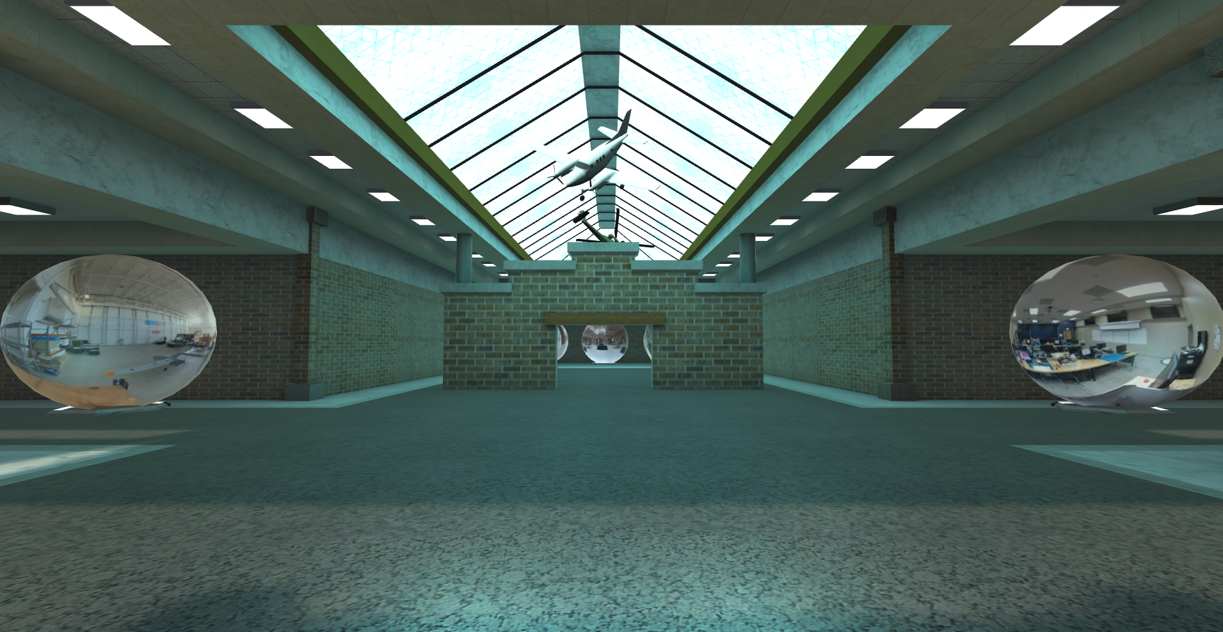
WORLDBUILDNG
In Altspace for MATE ROV Competition

Slide 2
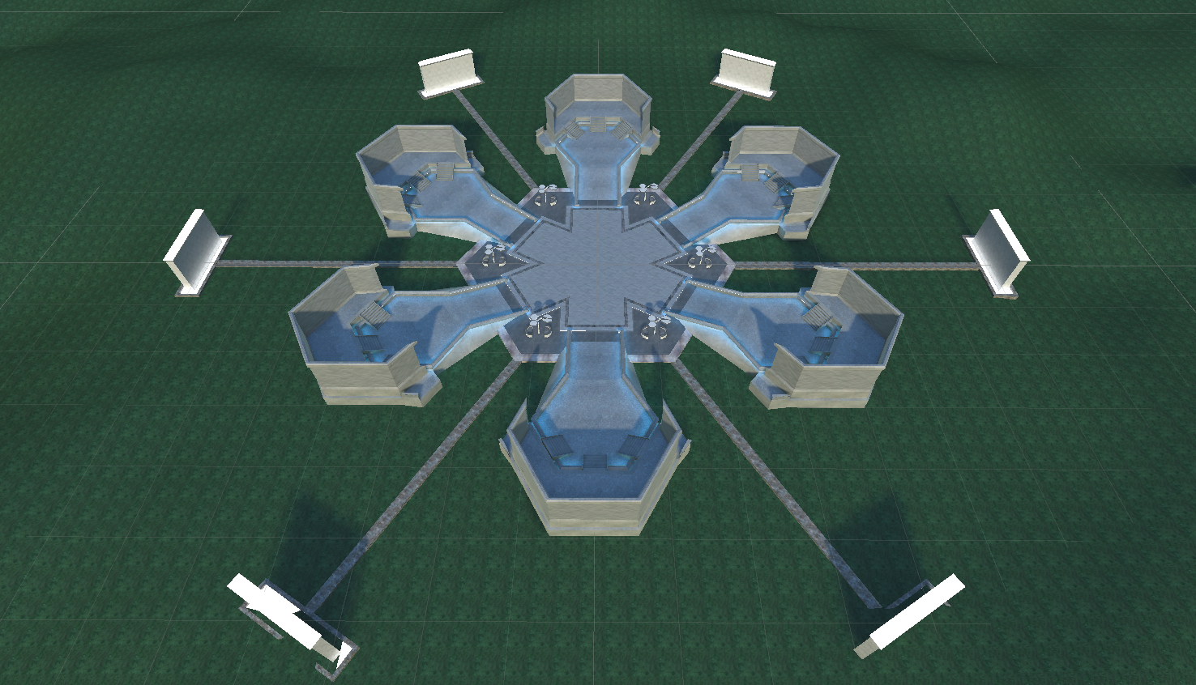
Workstations
Multiple copies of this space
6 teams per instance
Teams get one ‘Wedge’
Keep your work in your space

Slide 3
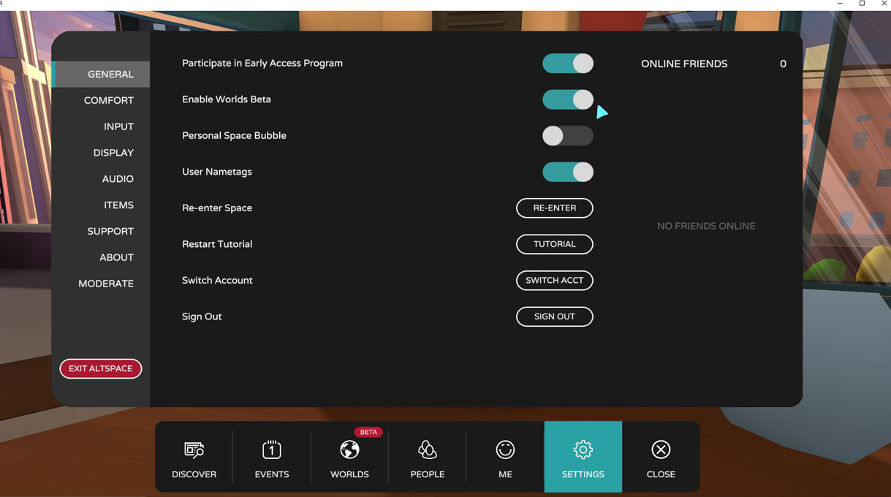
Worlds Beta

Slide 4
What you’ll need
Unity 2020.3.9
https://unity3d.com/get-unity/download/archive
Blender or the Modeling package of your choice
https://www.blender.org/download/
AltspaceVR Uploader Guide
https://docs.microsoft.com/en-us/windows/mixed-reality/altspace-vr/world-building/upgrading-content-to-the-latest-unity
Mixed Reality Feature Tool
https://www.microsoft.com/en-us/download/details.aspx?id=102778
https://dotnet.microsoft.com/download/dotnet/5.0

Slide 5
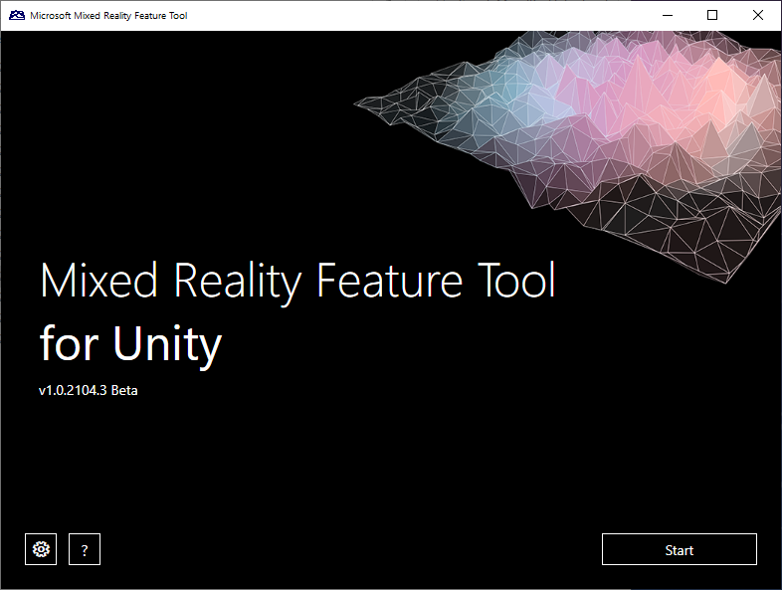
Altspace Uploader
Everything changed yesterday
Upgraded to Unity 2020.3
Changing rendering mode
Everything will have to be rebuilt
Need the MRFT to add the latest version of the tools to Unity

Slide 6
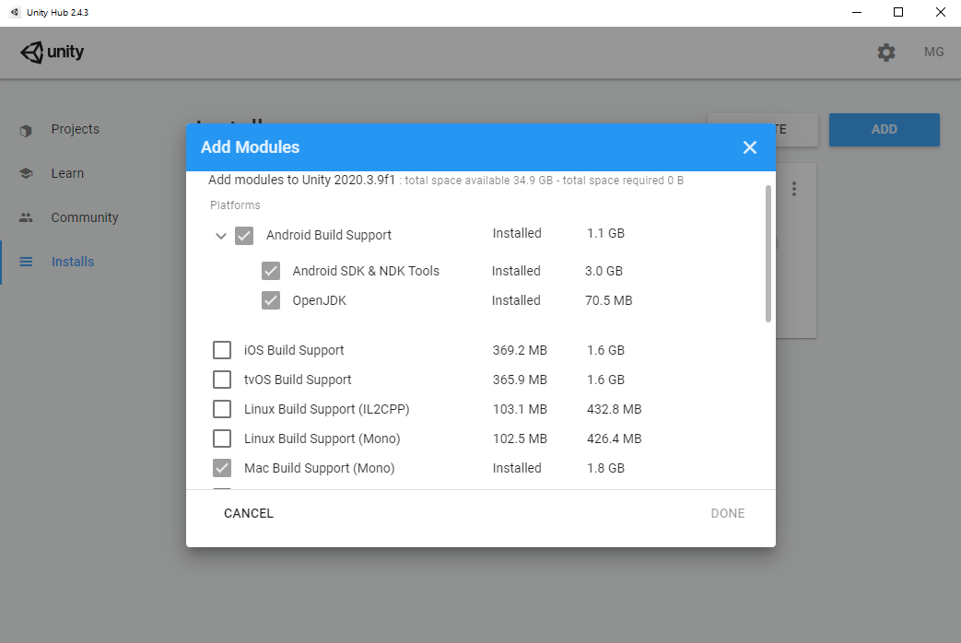
Use the right version of Unity
Unity Hub
useful for multiple versions
2020.3.9 is what I used
LTS versions
Android and Mac support
Need these to build

Slide 7
Workflow
3D Modeler
Blender
3ds MAX
FBX,OBJ .jpg .png
Unity 2020.3.9
Altspace Uploader
MR Feature Tool
AltspaceVR
Unity Doesn’t have any way to create content. All models and textures have to be created in some other software.
Images Textures
Blender
3ds MAX

Slide 8
The Pizza Slide

Slide 9
Altspace World Structure
Worlds have ‘weight’
Impact on performance
Limits Audience
Event support restrictions
All of these add to the weight
Balancing Act
Size,
Audience
ASVR Support
Special Effects
World
~40 MB
Kit Objects
Materials/Textures
Sounds
Models/Animation
MRE’s
Kit Objects
GLTF
Skybox
Template
Materials/Textures
Sounds
Models/Animation

Slide 10
Choose the right proportions
World
World
World
Kit Objects
Kit Objects
Textures
Sounds
Models
Kit Objects
Textures
Sounds
Models
Template
Textures
Sounds
Models
Skybox
Skybox
Template
Textures
Sounds
Models
Skybox
Template
blank

Slide 11
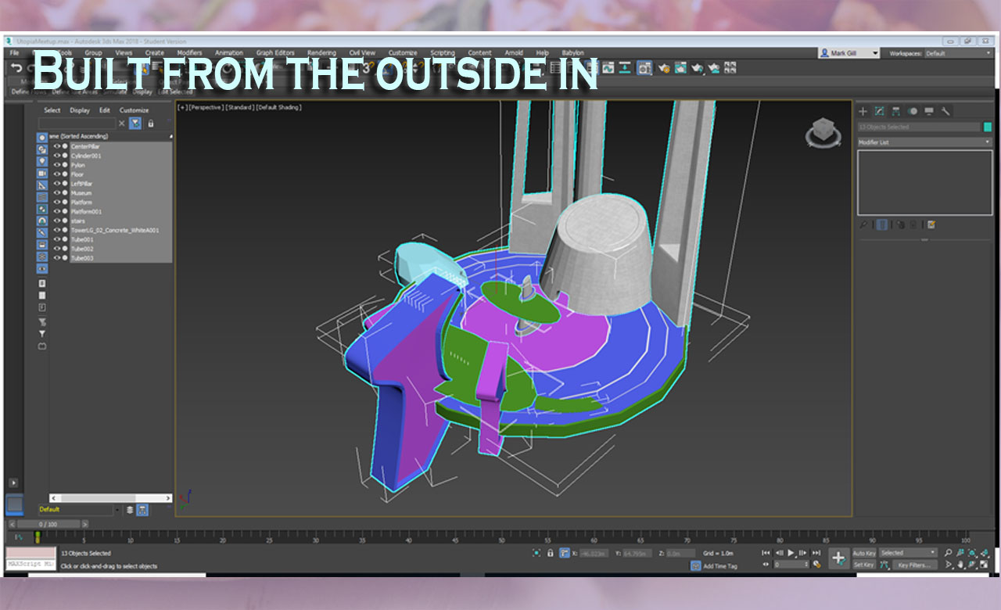
Making your models
3D Modeler (Blender, 3DS Max, Maya)
Focus on low poly count
< 100k
UV Maps
Animator (Unity)
Assign Materials in Unity
Small file size
< 1mb

Slide 12
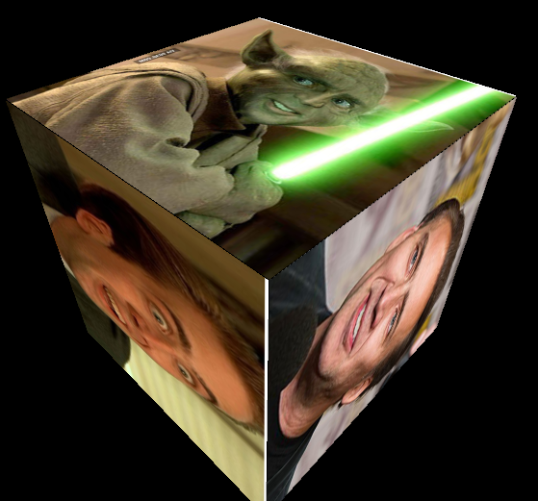
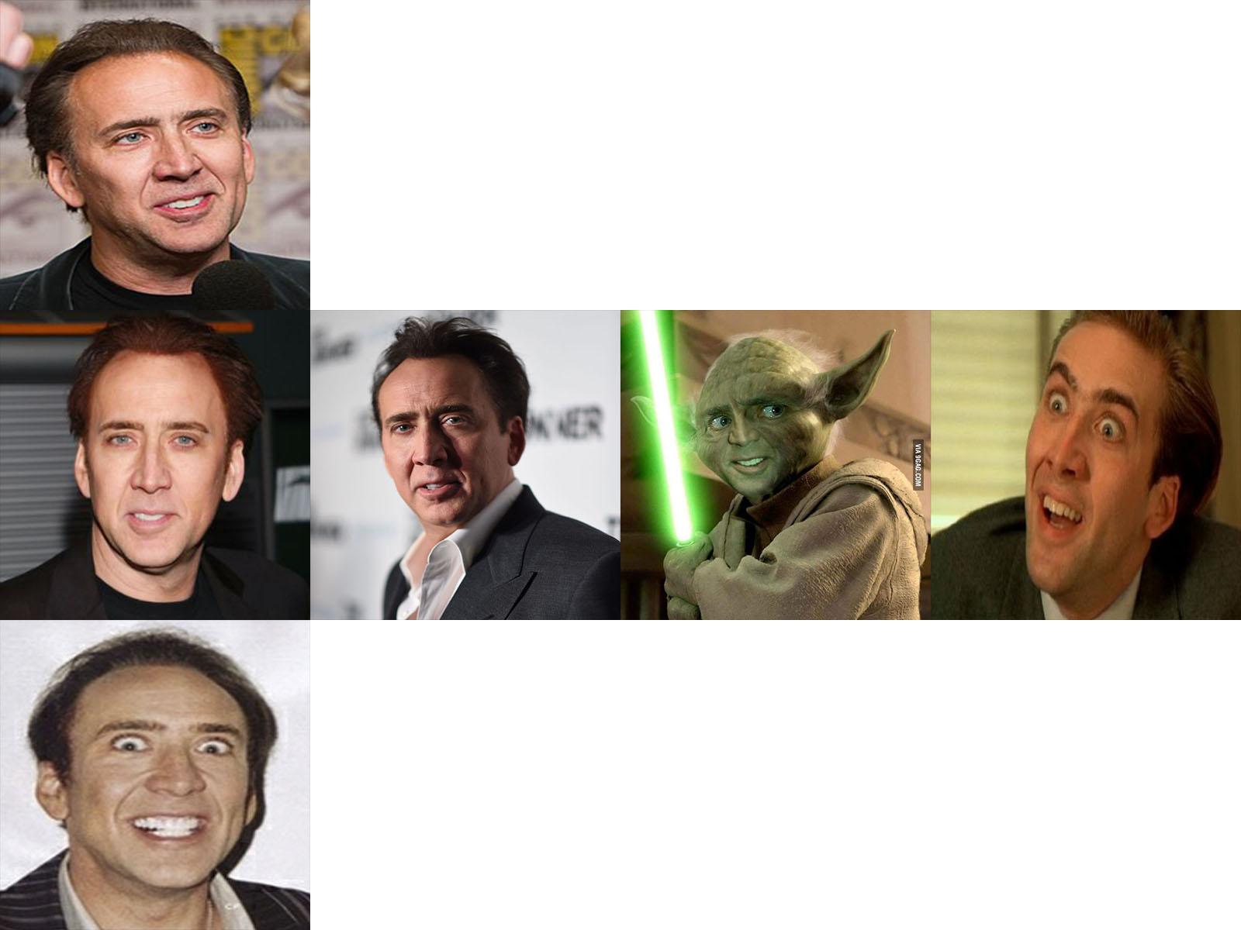
UV Coordinates
Needed for materials to appear correctly
Created in a modeling package (Blender, Max, Maya)
Can’t be modified in Unity

Slide 13
2 ways you can participate
Send us your stuff
Build your own world and we’ll like to it from here.

